Slide 1
Data Structures
Jiexin Wang
School of Software Engineering
South China University of Technology

Slide 2
Chapter 4-1
Tree I

Slide 3
Content
Definitions of tree
Binary tree
AVL tree
Splay tree
B-tree

Slide 4
Why Do We Need Trees?
Lists, Stacks, and Queues are linear relationships
Information often contains hierarchical relationships
  File directories or folders
  Hierarchies in organizations
  Moves in a game
Can build a tree to support fast searching

Slide 5
Tree Definition and Jargon
A tree is a set of nodes,i.e., either
  it’s an empty set of nodes, or
  it has one node called the root from which zero or more trees (subtrees) descend
root
nodes and edges
subtrees
leaves
parent, children, siblings
ancestors, descendants
path, path length
height, depth
A
B
C
D
E
F

Slide 6
More Tree Jargon
depth=0, height = 2
Length of a path = number of edges
Depth of a node N = length of path from root to N
Height of node N = length of longest path from N to a leaf
Depth of tree = depth of deepest node
Height of tree = height of root
A
B
C
D
depth=1,
height =0
E
F
depth = 2, height=0

Slide 7
Tree Trivia
Two nodes in a tree have at most one path between them
Can a non-zero path from node N reach node N again?
- No. Trees can never have cycles (loops)

Slide 8
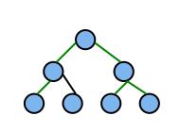
Paths
A tree with N nodes always has N-1 edges (prove it by induction)
Base Case: N=1 one node, zero edges
Inductive Hypothesis: Suppose that a tree with N=k nodes always has k-1 edges.
Induction: Suppose N=k+1…
The k+1st node must connect
to the rest by 1 or more edges.
If more, we get a cycle. So it connects by just 1 more edge
k
+1

Slide 9
Implementation of Trees
A
One possible pointer-based Implementation
  tree nodes with value and a pointer to each child
  but how many pointers should we allocate space for?
A more flexible pointer-based implementation
  1st Child / Next Sibling List Representation
  Each node has 2 pointers: one to its first child and one to next sibling
  Can handle arbitrary number of children
B
C
D
E
F

Slide 10
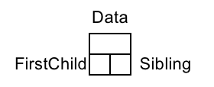
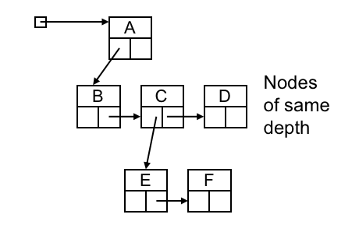
Arbitrary Branching
A
B
C
D
E
F

Slide 11
Implementation of Trees
//Node declarations for trees
Struct TreeNode{
Object element;
TreeNode *firstChild;
TreeNode *nextSibling;
};

Slide 12
Binary Trees

Slide 13
Binary Trees
Every node has at most two children
  Most popular tree in computer science
Given N nodes, what is the minimum depth of a binary tree?
  This means all levels but the last are full!
  At depth d, you can have N = 2^{d} to N = 2^{d+1}-1 nodes

Slide 14
Minimum depth vs node count
At depth d, you can have N = 2^{d} to 2^{d+1}-1 nodes
minimum depth d is Θ(log N)
T(n) = (f(n)) means
T(n) = O(f(n)) and f(n) = O(T(n)),
i.e. T(n) and f(n) have the same growth rate
1
d=2
N=2² to 2³-1
(i.e, 4 to 7 nodes)
2
3
4
5
6
7

Slide 15
Maximum depth vs node count
What is the maximum depth of a binary tree?
  Degenerate case: Tree is a linked list!
  Maximum depth = N-1
1
A linked list with high overhead
and few redeeming characteristics
2
3
4
5
6
7

Slide 16
Maximum depth vs node count
Goal: Would like to keep depth at around logN to get better performance than linked list for operations like Find

Slide 17
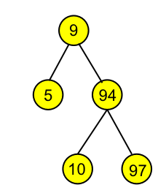
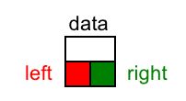
Binary Tree
template <typename E> class BinNode {
public:
virtual E& element() = 0; //return the node’s value
virtual void setElement(const E&) = 0; //set the node’s value
virtual BinNode* left() const = 0; //return the node’s left child
virtual void setLeft(BinNode*) = 0; //set the left child
virtual BinNode* right() const = 0; //return the right child
virtual void setRight(BinNode*) = 0; //set the right child
virtual bool isLeaf() = 0; //check if a node is a leaf or not
};

Slide 18
Traversing Binary Trees
The definitions of the traversals are recursive definitions. For example:
  Visit the root
  Visit the left subtree (i.e., visit the tree whose root is the left child) and do this recursively
  Visit the right subtree (i.e., visit the tree whose root is the right child) and do this recursively
Traversal definitions can be extended to general (non-binary) trees

Slide 19
Traversing Binary Trees
Preorder: Node, then Children (starting with the left) recursively
  + * + A B C D
Inorder: Left child recursively, Node, Right child recursively
  A + B * C + D
Postorder: Children recursively, then Node
  A B + C * D +
+
*
D
+
C
A
B

Slide 20
Traversing Binary Trees
//Implementing preorder traversal as a recursive
// function
template<typename E>
void preorder(BinNode<E>* root){
if (root == NULL) return; //Empty subtree
visit(root); //Perform desired action
preorder(root->left());
preorder(root->right());
}

Slide 21
Traversing Binary Trees
Given two traversal enumerations, can you draw a unique binary tree?
  Ex1:
    preorder: G H I J
    inorder: I H G J
  Ex2:
    Postorder: D E C B H G F A
    Inorder: B D C E A F H G
G
H
J
I
A
B
F
C
G
D
E
H

Slide 22
Binary Search Trees
Binary search trees are binary trees in which
  all values in the node’s left subtree are less than node value
  all values in the node’s right subtree are greater than value (not less than) node
Operations:
  find/contains, findMin, findMax, insert, delete
9
5
94
10
97
96
99
What happens when we traverse a BST in inorder?

Slide 23
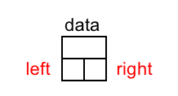
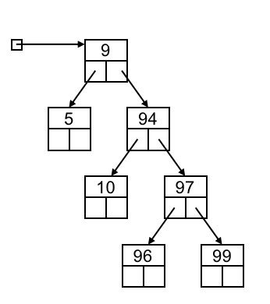
Binary Search Trees
9
5
94
10
97
96
99

Slide 24
find/contains
/**
* test if an item is in a subtree.
* x is item to search for.
* t is the node that roots the subtree.
*/
bool find( const Comparable & x, BinaryNode *t ) const{
if( t == nullptr ) return false;
else if( x < t->element ) return find( x, t->left );
else if( t->element < x ) return find( x, t->right );
else return true; // Match
}

Slide 25
findMin
Design recursive findMin operation that returns the smallest element in a binary search tree.
/**
* find the smallest item in a subtree t.
* Return node containing the smallest item.
**/
BinaryNode * findMin( BinaryNode *t ) const{
if( t == nullptr ) return nullptr; // root is empty
if( t->left == nullptr ) return t; //left child is empty
return findMin( t->left );
}

Slide 26
insert
Challenge: how to preserve the BST property without making major changes to the structure of the tree
  Do a “find” operation for X
  If X is found → do nothing (or update something)
  Else, “find” stops at a NULL pointer
  Insert Node with X there
Example: Insert 95
94
94
10
97
?
10
97
96
99
96
99
95

Slide 27
insert
How to handle duplicates?
Example: Insert 97
94
94
10
97
10
97
?
96
99
96
99
97
Construct a new node and insert it into the tree. or,
Keeping an extra field in the node record indicating the frequency of occurrence, etc.

Slide 28
insert
/**
* Internal method to insert into a subtree.
* x is the item to insert.
* t is the node that roots the subtree.
* Set the new root of the subtree.
*/
void insert( const Comparable & x, BinaryNode * & t ){
if( t == nullptr )
t = new BinaryNode{ x, nullptr, nullptr };
else if( x < t->element )
insert( x, t->left );
else if( t->element < x )
insert( x, t->right );
else
; // Duplicate; do nothing
}

Slide 29
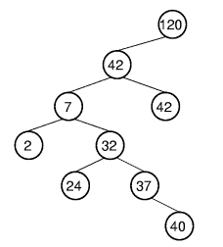
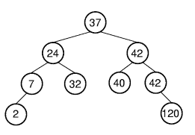
insert
The shape of a BST depends on the order in which elements are inserted.
  Left BST: 37, 24, 42, 7, 2, 40, 42, 32, 120
  Right BST: 120, 42, 42, 7, 2, 32, 37, 24, 40
What if nodes are inserted in a sorted order?

Slide 30
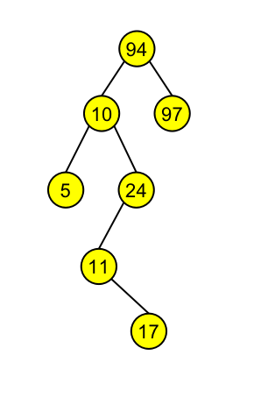
remove(delete)
Delete is a bit trickier…Why?
Suppose you want to delete 10
Strategy:
  Find 10
  Delete the node containing 10
Problem: When you delete a node,
what do you replace it by?

Slide 31
remove(delete)
Problem: When you delete a node,
what do you replace it by?
Solution:
  If it has no children, by NULL
  If it has 1 child, by that child
  If it has 2 children, by the node with
  the smallest value in its right subtree
  (the successor of the node)

Slide 32
remove(delete)
Delete node with no children
94
94
10
97
10
97
Find 5 node
5
24
Then Free the 5 node and NULL the pointer to it
5
24
11
11
17
17

Slide 33
remove(delete)
Delete node with one children
94
94
10
97
10
97
Then Free the 24 node and replace the pointer to it with a pointer to its child
Find 24 node
5
24
5
24
11
11
17
17

Slide 34
remove(delete)
Delete node with two children
94
94
10
97
11
97
5
24
5
24
11
11
17
17
Find 10, Copy the smallest value in right subtree into the node
Then (recursively) Delete node with smallest value in right subtree Note: it cannot have two children (why?)

Slide 35
remove(delete)
Delete node with two children（continued）
94
94
11
97
11
97
5
24
5
24
11
11
17
17
Then Free the 11 node and replace the pointer to it with a pointer to its child
Remember 11 node

Slide 36
remove(delete)
/**
* remove from a subtree. Textbook page 140
* x is the item to remove. t is the node that roots the subtree.
* Set the new root of the subtree.
*/
void remove( const Comparable & x, BinaryNode * & t ){
if( t == nullptr ) return; // Item not found; do nothing
if( x < t->element ) remove( x, t->left );
else if( t->element < x ) remove( x, t->right );
else if( t->left != nullptr && t->right != nullptr ){// Two children
t->element = findMin( t->right )->element;
remove( t->element, t->right );
}
else{
BinaryNode *oldNode = t;
t = ( t->left != nullptr ) ? t->left : t->right;
delete oldNode;
}
}

Slide 37
Analysis of BST
Cost of finding, insertion, and removal (one node) is the depth of the deepest node in the tree
  Balanced BST in average case: Θ(log n)
  Unbalanced BST in worst case: Θ(n)
  Desirable to keep BSTs balanced, that is, with least possible height
Traverse cost: Θ(n)
It is preferable for a BST to be as shallow as possible

Slide 38
Homework
Homework 3-1
  Textbook Exercises 4.2, 4.5, 4.9

